Slide 1

DATE
Mhareon
Citizenship 9

Slide 2
TABLE OF CONTENTS
TABLE OF CONTENTS
WHERE
1
2
3
4
Personal
Community
Global
Aspirational

Slide 3
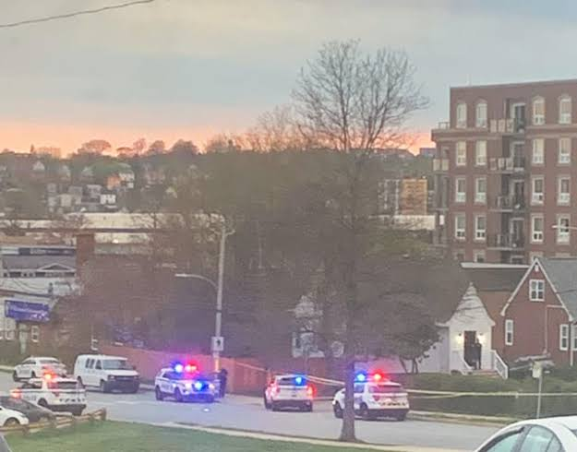
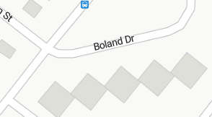
The Personal Place
Cit 9 WHERE
MAP SCREENSHOT (from Bing Maps) | Reflection: Write about a personal place that holds significance for you. Tell the story of the place! I loved riding around in my Lightning McQueen car everywhere I went. My family was always right there with me while I drove it. My aunts and uncles lived close by, so they came over to visit us a lot. All of my best friends lived in the same area too. Because everyone was so close, I always had someone to play with. Guiding Questions: In a second section, describe how your personal perspective shapes the way you see and feel about this place. What stories or memories are tied to this specific location? And this place is also where i used to hangout with my friends when i was a baby. | IMAGE
Notes:
The Personal Place
Reflection: Write a paragraph about a personal place that holds significance for you.
Guiding Questions:: In a second section, describe how your personal perspective shapes the way you see and feel about this place. What stories or memories are tied to this specific location?

Slide 4
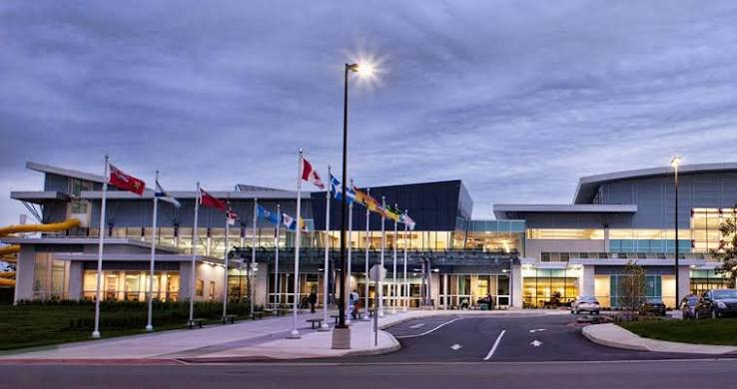
The Community Place
Cit 9 WHERE
MAP SCREENSHOT | Reflection: Write about a significant place in our local community. Tell the story of the place! Who owns it? Why do you like it? Describe something that happened there that you remember. | IMAGE
Notes:
Reflection: Write about a significant place in our local community. Tell the story of the place! Who owns it? Why do you like it? Describe something that happened there that you remember.

Slide 5
The Global Place
Cit 9 WHERE
MAP SCREENSHOT | Reflection: Write a story about a place in the world that is part of your family's story. Guiding Questions: Tell the story of how you and/or your family are connected to this place. What traditions or values from this place have been passed down to you? How does this connect to your cultural identity, including things you do and who you are? | IMAGE
Notes:
Reflection: Write a story about a place in the world that is part of your family's story.
Guiding Questions: Tell the story of how you and/or your family are connected to this place.
What traditions or values from this place have been passed down to you?
How does this connect to your cultural identity, including things you do and who you are?

Slide 6
The Aspirational Place
Cit 9 WHERE
MAP SCREENSHOT | Reflection: Write a story about a place you have never been to but dream of visiting. Guiding Questions: What draws you to this place? What do you hope to learn or experience there? How does this place fit into your hopes for the future? | IMAGE
Notes:
Reflection: Write a story about a place in the world that is part of your family's story.
Guiding Questions: What draws you to this place? What do you hope to learn or experience there? How does this place fit into your hopes for the future?

Slide 7
The Aspirational Place
Cit 9 WHERE
Soundtrack of your life | Post the youtube link here | What’s the story on the song? Write here!
Notes:
Reflection: Write a story about a place in the world that is part of your family's story.
Guiding Questions: What draws you to this place? What do you hope to learn or experience there? How does this place fit into your hopes for the future?

Slide 8
THANK YOU

